Slide 1
BRIGHT MOTORS
Car Sales Performance
DATASET
548K
From raw data to executive insight
vehicles sold
across 38 states & 66 makes
Junior Data Analyst Case Study
Prepared for the Head of Sales • May 2026

Slide 2
BRIGHT MOTORS | CAR SALES CASE STUDY
2014–2015
Agenda
What we'll cover today
01
Business Context
Why this analysis matters for Bright Motors
02
Data & Methodology
From raw Databricks export to clean, query-ready data
03
Headline KPIs
Revenue, units, price and margin at a glance
04
Brand & Geography
Where revenue concentrates by make and state
05
Time, Mix & Margin
Seasonality, body-type mix and profitability tiers
06
Recommendations
Actions for the next planning cycle
Source: Bright Motors car_sales_dataset (Databricks)

Slide 3
BRIGHT MOTORS | CAR SALES CASE STUDY
2014–2015
Why this matters
Turning 548K transactions into a clear sales story
THE QUESTION
REVENUE ANALYSED
Where is Bright Motors making money — and where are we leaving it on the table?
$7.5B
UNITS SOLD
We analysed every sale from 2014–2015 to identify the brands, regions, vehicle types and price points that drive revenue and margin, so leadership can prioritise inventory and marketing spend for the next cycle.
548K
MARKETS COVERED
38 states
Source: Bright Motors car_sales_dataset (Databricks)

Slide 4
BRIGHT MOTORS | CAR SALES CASE STUDY
2014–2015
Data & methodology
From raw export to query-ready insight
STEP 1
STEP 2
STEP 3
STEP 4
STEP 5
Extract
Clean
Transform
Aggregate
Visualise
Pulled the full car_sales_dataset from Databricks (558K raw rows).
Standardised text, fixed the 'Tue Dec 16 2014…' date format, dropped invalid prices. 548K rows retained.
Derived profit, profit %, vehicle age, sale_month, year and margin tiers.
Built pivots by make, state, month, body, color, year & margin tier.
Excel dashboard + PowerPoint deck for the Head of Sales.
Tools: Databricks SQL • Python (pandas, openpyxl) • Microsoft Excel • PowerPoint • Looker Studio
Source: Bright Motors car_sales_dataset (Databricks)

Slide 5
BRIGHT MOTORS | CAR SALES CASE STUDY
2014–2015
Headline KPIs
The numbers that frame everything else
TOTAL REVENUE
UNITS SOLD
AVG SELLING PRICE
AVG PROFIT MARGIN
$7.51B
548,400
$12,531
-1.0%
across 548K sold vehicles
valid transactions retained
per vehicle, all segments
fleet-wide — pricing pressure
UNIQUE MAKES
UNIQUE MODELS
STATES COVERED
MONTHS IN RANGE
66
973
38
10
Takeaway: strong volume and revenue, but a slightly negative fleet margin signals over-discounting in a few large segments — the next slides show where.
Source: Bright Motors car_sales_dataset (Databricks)

Slide 6
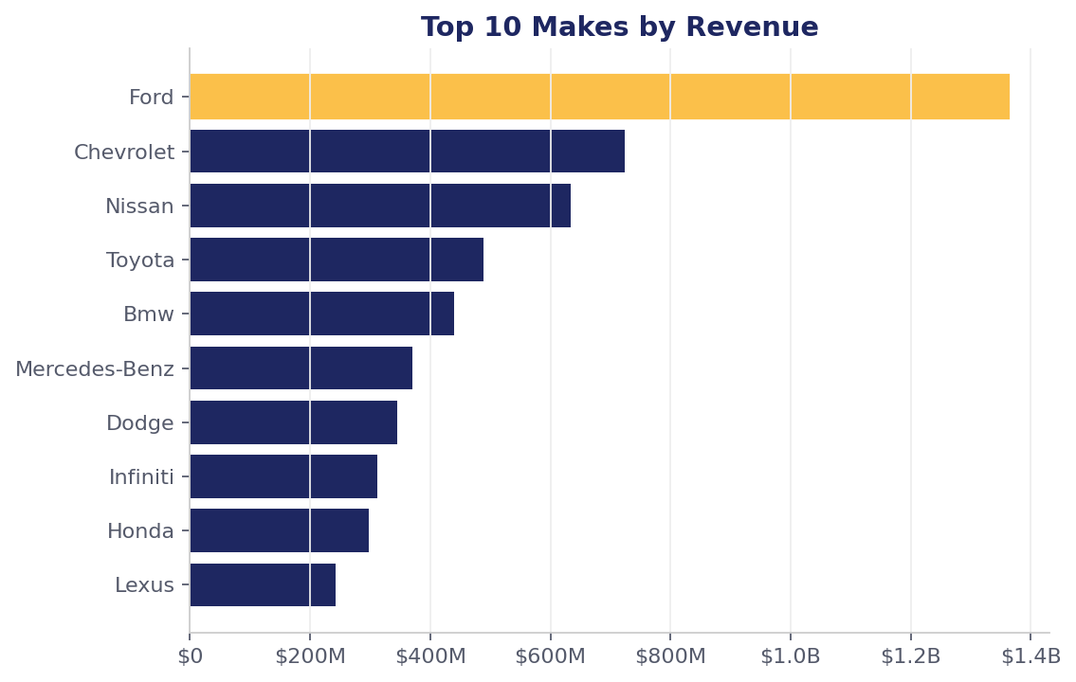
BRIGHT MOTORS | CAR SALES CASE STUDY
2014–2015
Top brands by revenue
Ford, Chevrolet and Nissan dominate the book
WHAT THE DATA SAYS
• Ford leads with $1.36B revenue from 94K units — our anchor brand.
• Top 5 makes (Ford, Chevy, Nissan, Toyota, BMW) drive ~50% of revenue.
• Premium brands (BMW, Mercedes, Lexus) carry the strongest avg prices ($18K–$22K).
• Mercedes-Benz & Lexus are the only top brands with positive avg margins.
Source: Bright Motors car_sales_dataset (Databricks)

Slide 7
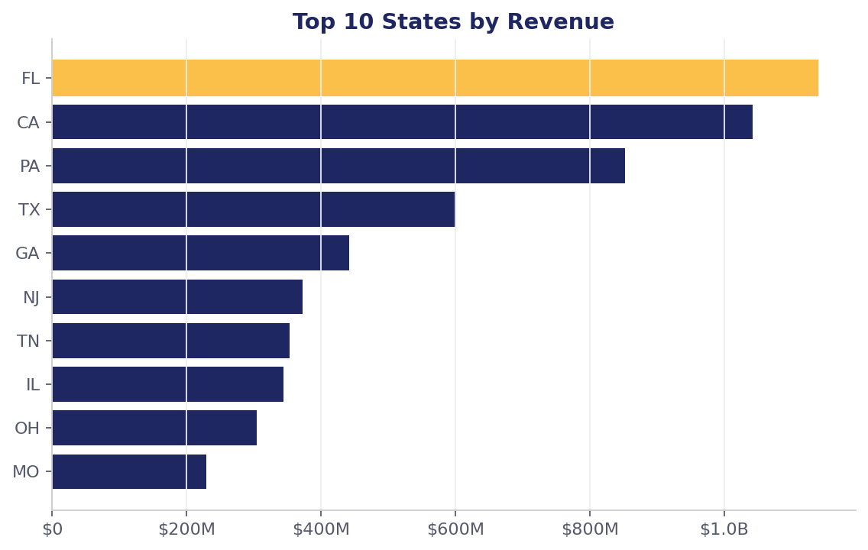
BRIGHT MOTORS | CAR SALES CASE STUDY
2014–2015
Where we sell
Florida and California lead a concentrated geography
STATE PERFORMANCE
• FL #1: $1.14B revenue, 81K units sold.
• Top 3 states (FL, CA, PA) generate ~40% of total revenue.
• PA shows the highest avg price among top states ($15,898) — premium-mix opportunity.
• Long tail: 28 states each contribute < 2% of revenue — review distribution costs.
Source: Bright Motors car_sales_dataset (Databricks)

Slide 8
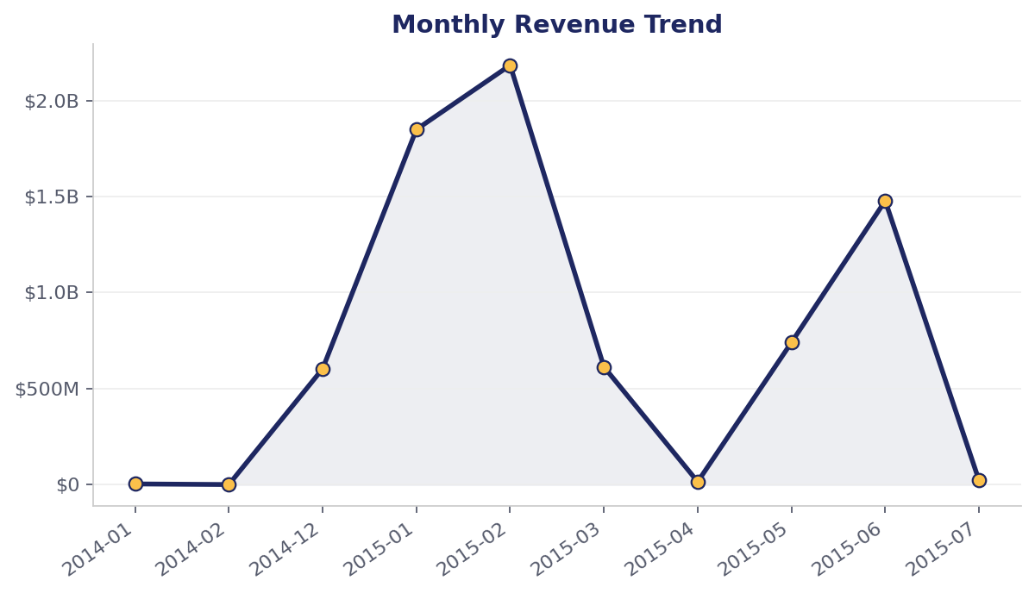
BRIGHT MOTORS | CAR SALES CASE STUDY
2014–2015
Sales over time
A clear seasonal peak in early 2015
PEAK MONTH
Feb 2015
$2.18B revenue
159K units in a single month
Jan–Feb 2015 alone delivered 54% of two-year revenue. Plan inventory and staffing to absorb this Q1 wave; investigate the Mar–Apr drop for stock-out or cannibalisation effects.
Source: Bright Motors car_sales_dataset (Databricks)

Slide 9
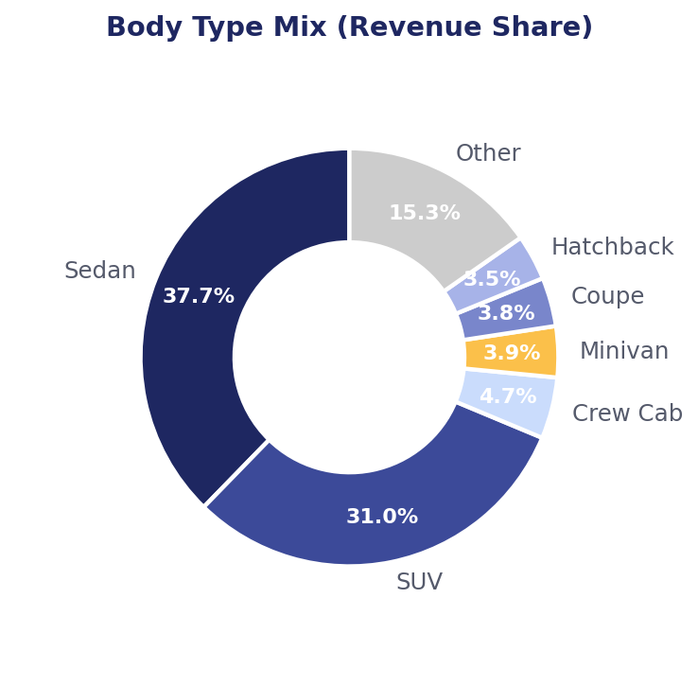
BRIGHT MOTORS | CAR SALES CASE STUDY
2014–2015
Vehicle mix
Sedans and SUVs are two-thirds of the business
MIX HIGHLIGHTS
• Sedans lead with $2.82B revenue (38% share) — but lowest avg price ($10.3K).
• SUVs deliver $2.32B at a higher avg price ($14.7K) — best volume/value combo.
• Crew cab & supercrew trucks outperform on avg price ($20K+) but on small volume.
• Minivans & hatchbacks underperform on margin — review trim & pricing.
Source: Bright Motors car_sales_dataset (Databricks)

Slide 10
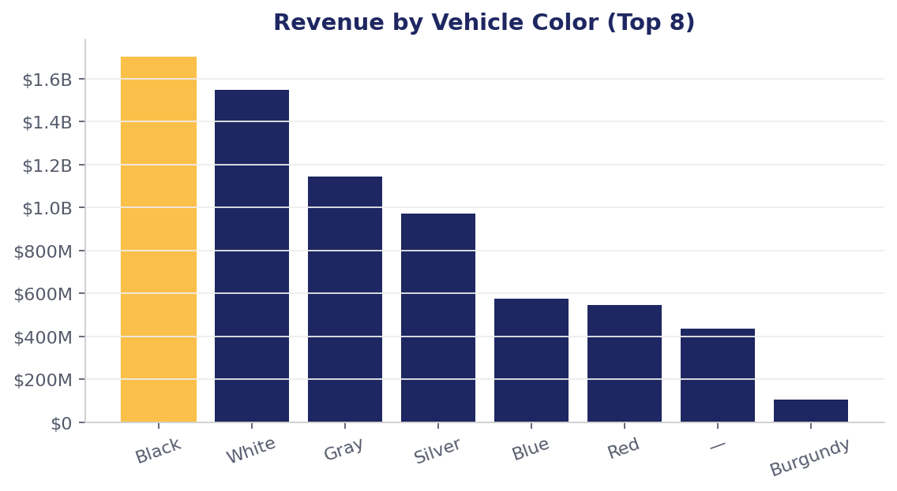
BRIGHT MOTORS | CAR SALES CASE STUDY
2014–2015
Color preference
Black, white and grey rule the lot
INVENTORY IMPLICATION
• Black ($1.70B) and white ($1.55B) together = 43% of revenue.
• Top 4 neutral colors (black/white/grey/silver) = 72% of revenue.
• Bold colors (red, orange, purple) sell in low volume — price as accents, not core stock.
• Action: anchor inventory on the neutral 4, treat the rest as long-tail orders.
Source: Bright Motors car_sales_dataset (Databricks)

Slide 11
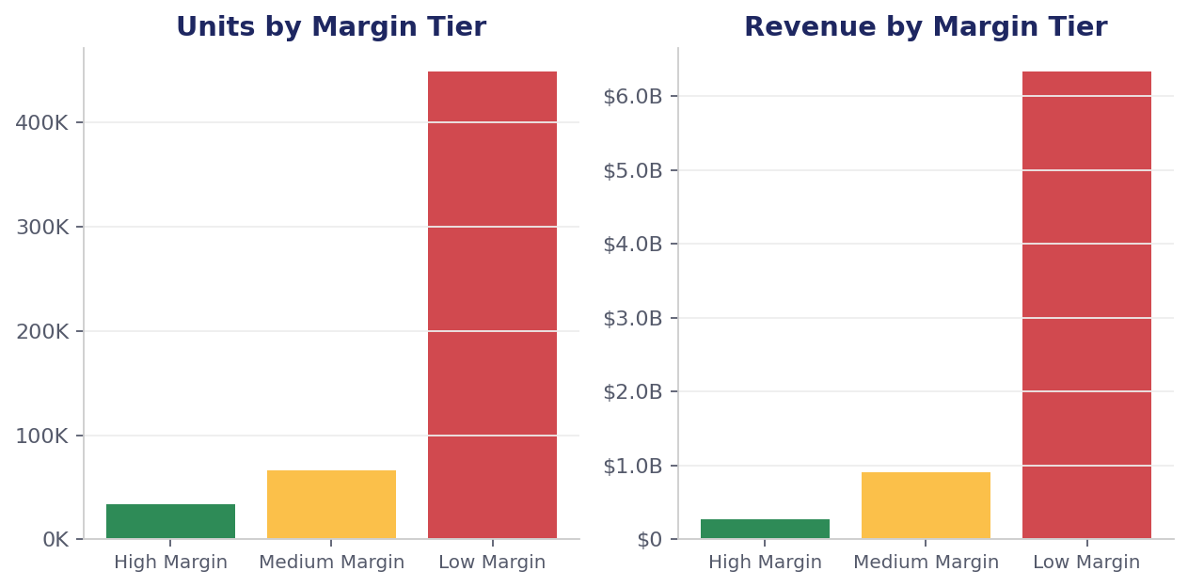
BRIGHT MOTORS | CAR SALES CASE STUDY
2014–2015
Profitability tiers
Most volume sits in the Low-Margin tier — our biggest lever
THE BIG INSIGHT
82%
of units sold land in the
Low-Margin tier (-10% avg).
Shifting just 5% of these units up to Medium tier would add ~$50M in incremental margin, with no extra volume required.
Source: Bright Motors car_sales_dataset (Databricks)

Slide 12
BRIGHT MOTORS | CAR SALES CASE STUDY
2014–2015
Recommendations
Five moves for the next planning cycle
1
Double-down on top brands
Secure inventory commitments with Ford, Chevy, Nissan, Toyota and BMW — they drive ~50% of revenue.
2
Prioritise FL, CA, PA
These three states deliver 40% of revenue. Concentrate marketing spend and lead the Q1 push there.
3
Plan for the Q1 surge
Pre-position stock and staffing for Jan–Feb; investigate the Mar drop to recover lost units.
4
Lead with Sedan + SUV
Keep sedans for volume, SUVs for value. Trim slow body types (minivan, hatchback) on poor margin.
5
Fix the margin mix
Move 5% of Low-Margin units up a tier through pricing & trim — biggest profit lever in the dataset.
Source: Bright Motors car_sales_dataset (Databricks)

Slide 13
Thank you.
Questions, ideas, next experiments — let's discuss.

